Slide 1
Object Oriented System Design
Assignment #2

Slide 2
Game cafe: Part 2
This assignment uses the code base you created in the first assignment.
Game types (board, card, electronic)
I/O File handling
Exception handling
Saving game state

Slide 3
Abstract Class Game
Variables:
private String name
private double price
protected int quality // 0-100
Methods:
Game(String name, double price, int quality)
public String toString(); // Returns game’s name, quality and price
public void repair(); // Sets the quality of the game to 100
public abstract double getRepairCost();
public abstract void lowerQuality(); // Lowers the quality of the game
public abstract String getQuality();

Slide 4
Class BoardGame: Extends Game
Methods:
public double getRepairCost(); // $0.04 per quality point
public void lowerQuality(); // Lowers the quality of the game by 25 points
public String getQuality(); // Quality > 70 == Good, 70-50 == Okay, < 50 == Bad

Slide 5
Class CardGame: Extends Game
Methods:
public double getRepairCost(); // $0.02 per quality point
public void lowerQuality(); // Lowers the quality of the game by 30 points
public String getQuality(); // Quality > 60 == Good, 60-25 == Okay, < 25 == Bad

Slide 6
Class ElectronicGame: Extends Game
Methods:
public double getRepairCost(); // $0.06 per quality point
public void lowerQuality(); // Lowers the quality of the game by 20 points
public String getQuality(); // Quality > 80 == Good, 80-60 == Okay, < 60 == Bad

Slide 7
Class CSVLoader
Methods:
public Game[] loadGames(String fileName); // create games based on a CSV file
public void saveGames(Game[] games, String fileName); // write games to a CSV file
Example files will be available in the assignment description.

Slide 8
Main class
method main:
Initialize the CSVLoader
Initialize the Cafe
Rent out a game until it’s quality is ‘bad’ and repair it.
Rent out more games until you have enough money to buy a new one (think of one yourself).
Buy a new game.

Slide 9
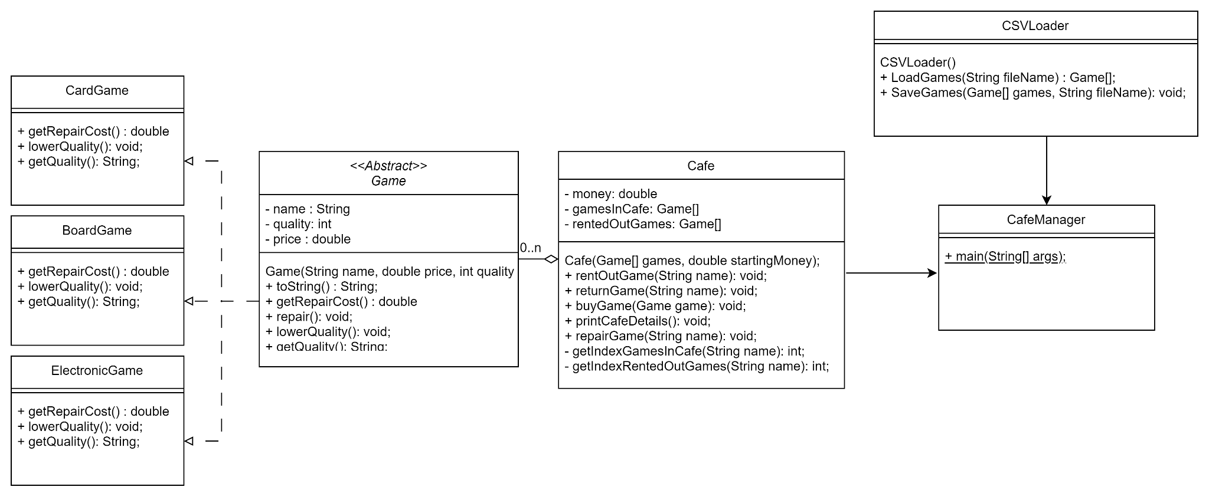
UML

Slide 10
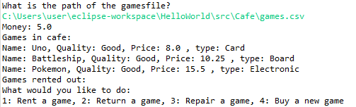
Visualization
Initialization

Slide 11
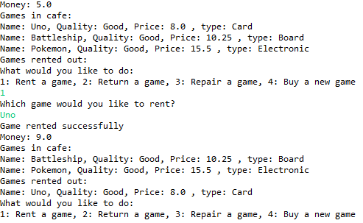
Visualization
Renting a game

Slide 12
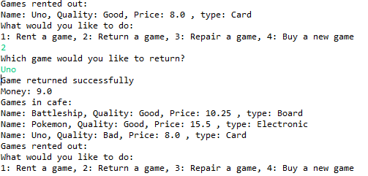
Visualization
Returning a game

Slide 13
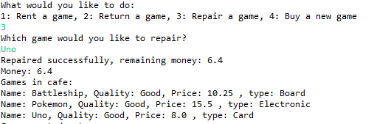
Visualization
Repairing a game

Slide 14
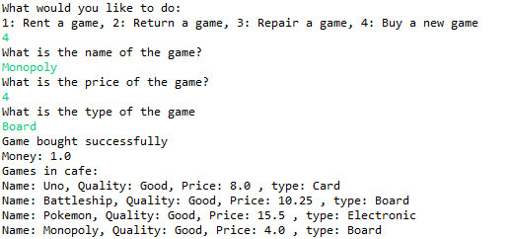
Visualization
Buying a game

Slide 15

Visualization
Saving games

Slide 16
Rules
Only regular arrays [], no Lists or Maps.
Use getters and setters when needed and only make them public if they are actually meant to be used from outside the class.
Reading code is more difficult than writing code, place comments in complex methods.

Slide 17
Rules (2)
You are not allowed to add extra arrays for the games, make use of the existing gamesInCafe and rentedOutGames arrays.
You are not allowed to use external libraries to read the CSV file.
The CSVLoader has to utilize exception handling
The system should not crash when the given filename is not found.
The system should not crash when the data in the file is not well formatted (ex: empty file, wrong data types).

Slide 18
Submission
Submit your program code package(Assignment2_code_이름_학번) and design document (Assigment2_이름_학번) in LMS. (Korean/English)
The design document describes the main methods, flow of the code and overall design of the program. It should also mention and explain every method that you added that was not described in this powerpoint.
Deadline: 19th of may (5월 19일) 23:59
Late penalties:
Up to 24 hours = -25%,
24-48 hours = -50%,
48-72 hours = -75%
after 72 Hours you get an automatic 0.

